Slide 1
Restaurant Analysis of the 10 Best Foodie Cities in America
Fawad Ali
Hamza Sakr
Stephen Vo

Slide 2
Top Restaurant data
Data was obtained from Yelp and Google Maps API’s
City data was identified from this article – Ten Best “Foodie” Cities in America from CNBC https://www.cnbc.com/2018/11/05/wallethub-best-food-cities-in-america.html

Slide 3
Project Description and Goals
People like food and they like to eat out. A lot. According to the article on the previous slide, Portland is the best “foodie:” city. We are going to look at the top cuisines in 10 major metropolitan cities and compare the following in each city:
Which cuisines are most popular?
Which cities are the priciest to dine out?
What are the top 5 rated restaurants?

Slide 4
Dataset
The top 50 restaurants were pulled from Yelp then filtered for price, rating and category/cuisine
Restaurants that were in multiple categories were filtered so they would only appear once in the analysis
Categories that weren’t actual cuisine types, such as ”Food” or “Flea Markets” were removed from the dataset.
Restaurants that did not contain a price rating were also removed from the dataset

Slide 5
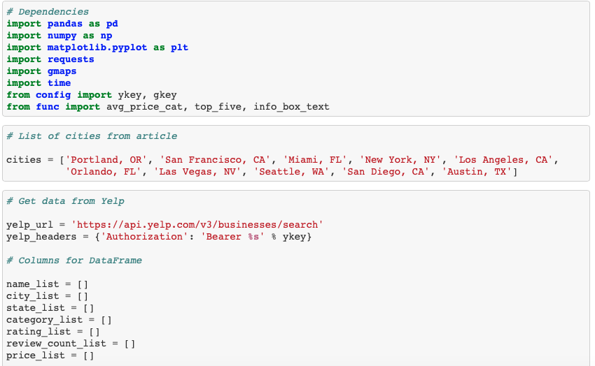

Slide 6
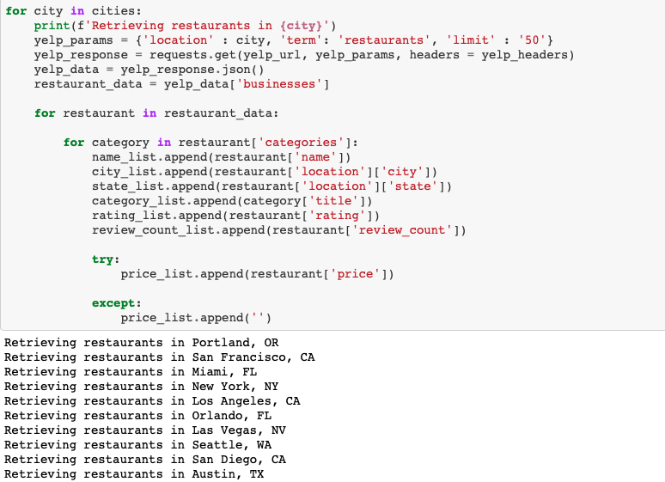

Slide 7
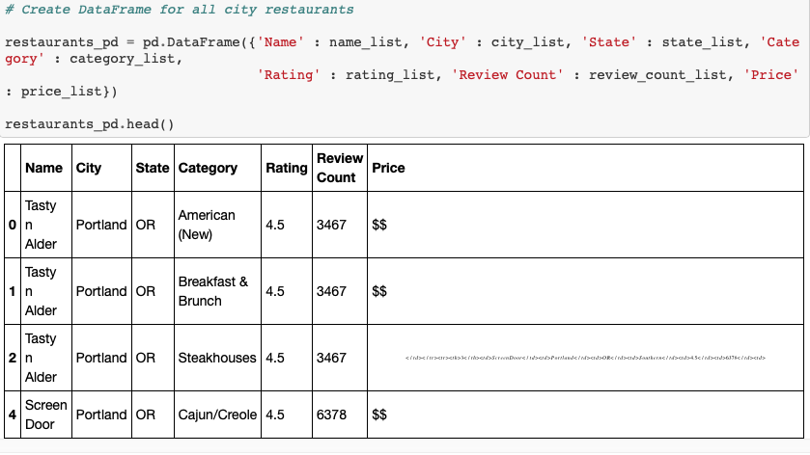

Slide 8
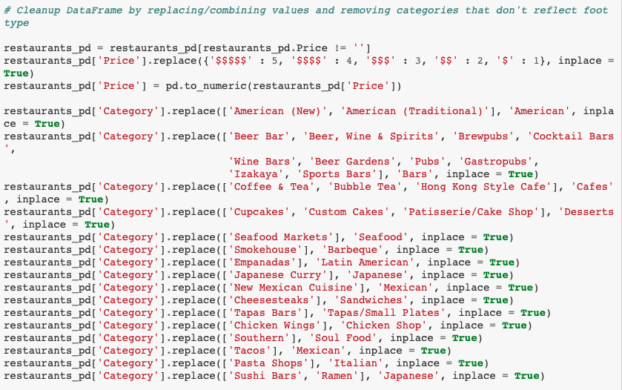

Slide 9
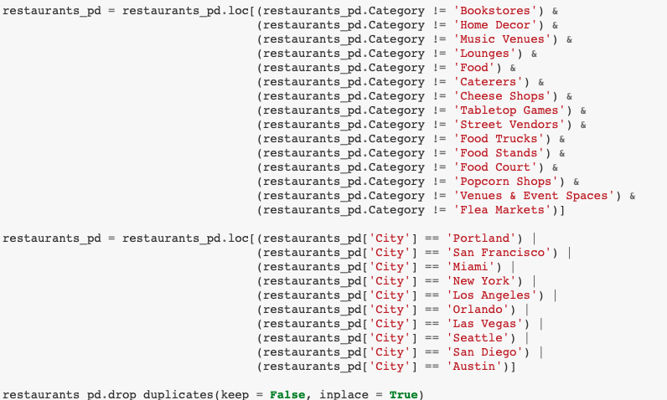

Slide 10
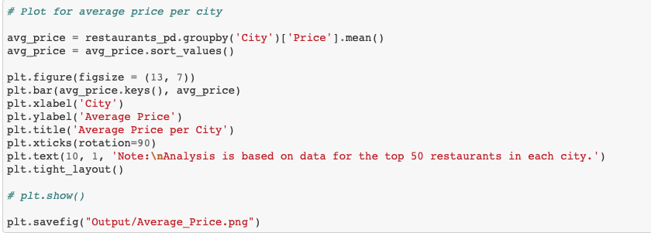

Slide 11
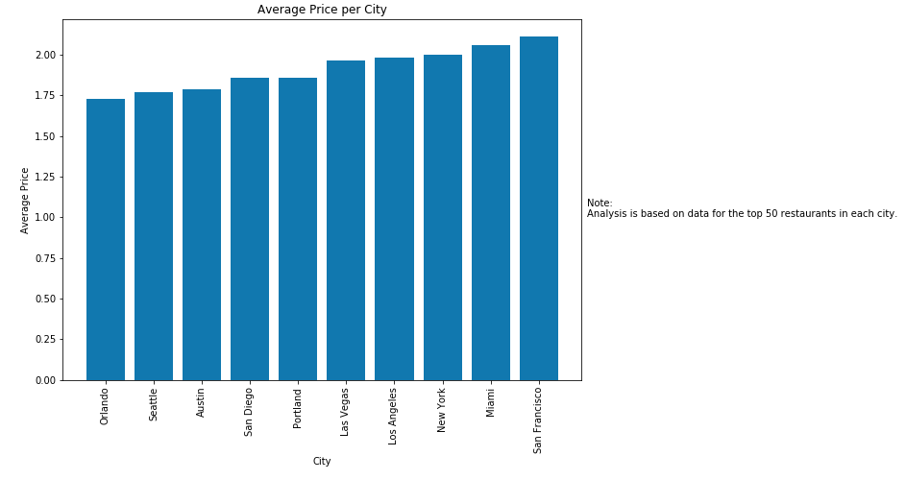

Slide 12
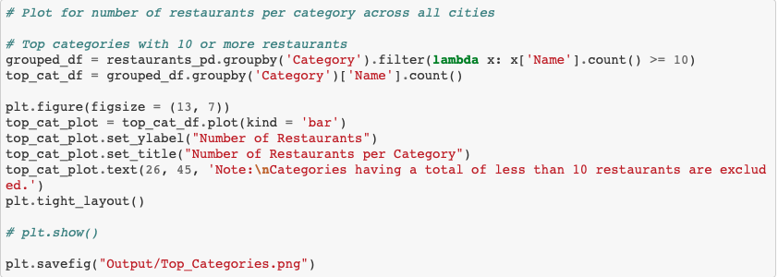

Slide 13
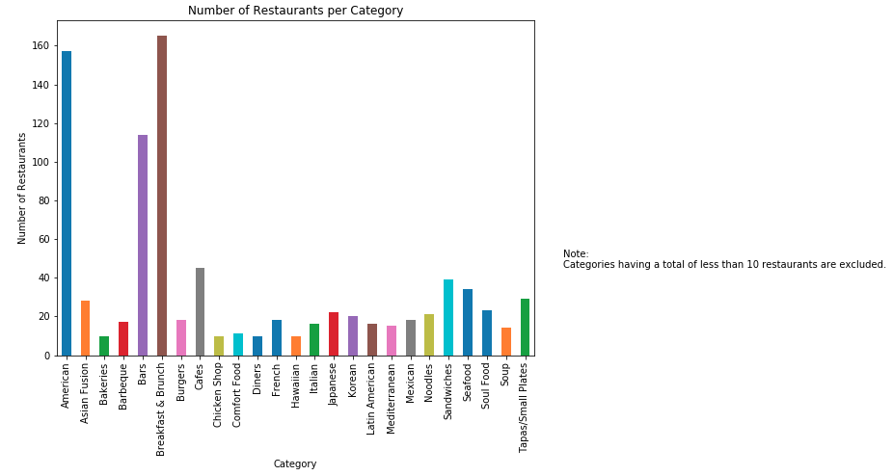

Slide 14
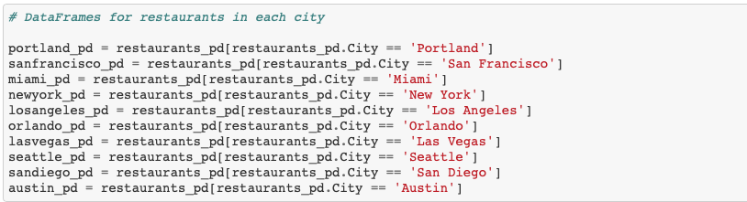

Slide 15
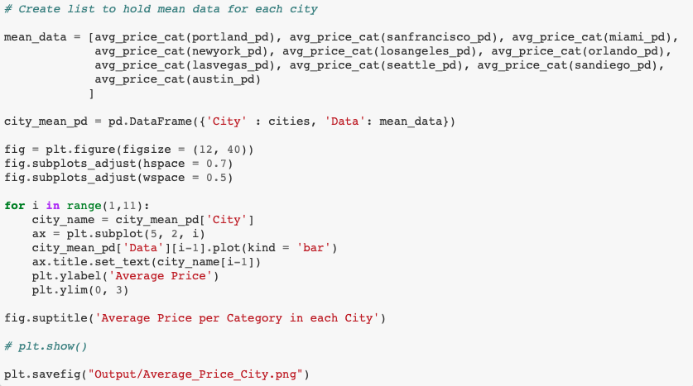

Slide 16
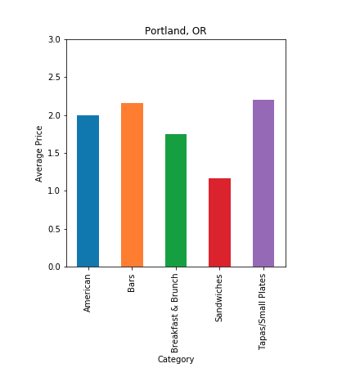

Slide 17
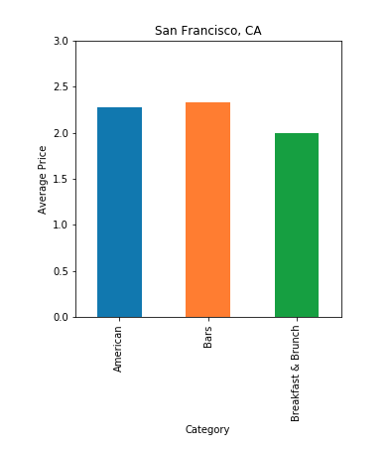

Slide 18
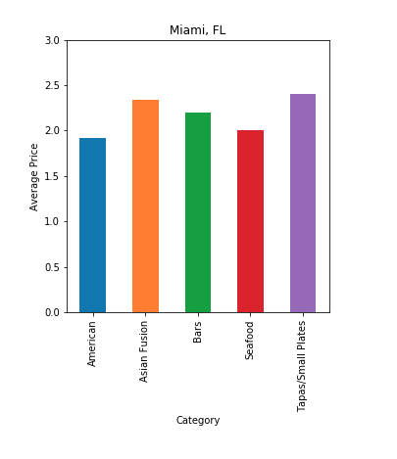

Slide 19
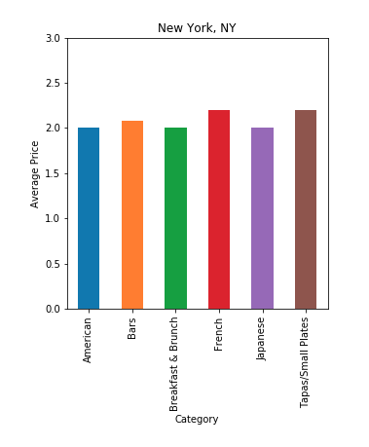

Slide 20
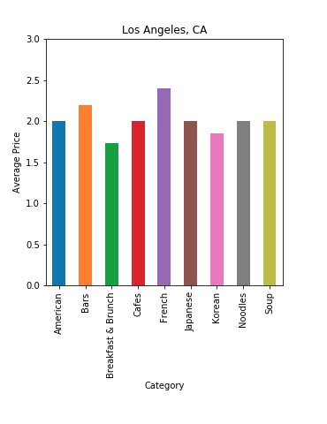

Slide 21
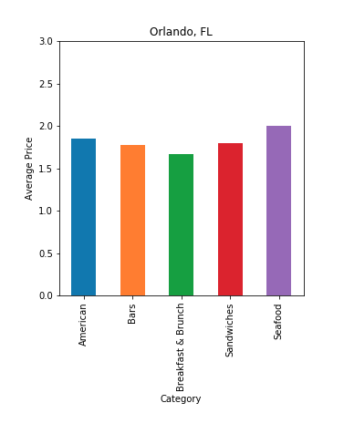

Slide 22
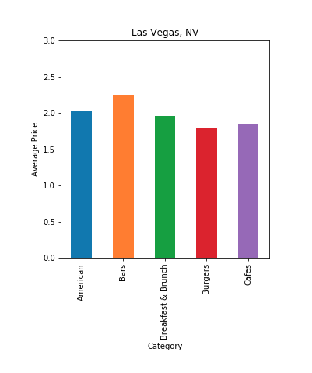

Slide 23
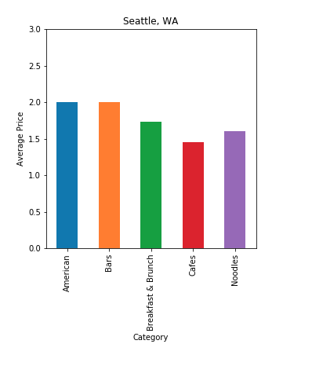

Slide 24
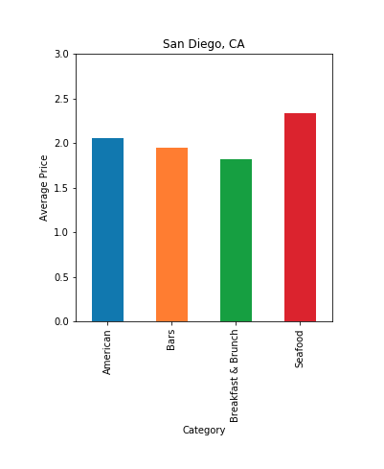

Slide 25
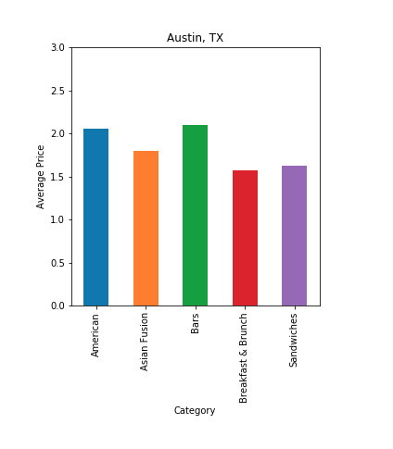

Slide 26
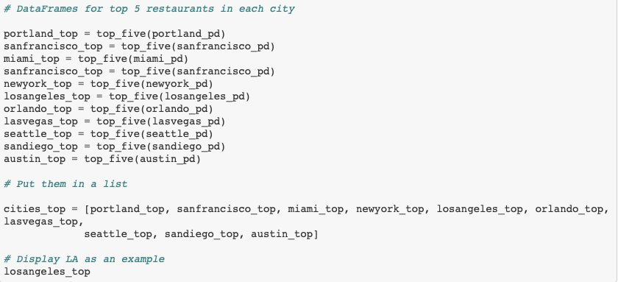

Slide 27
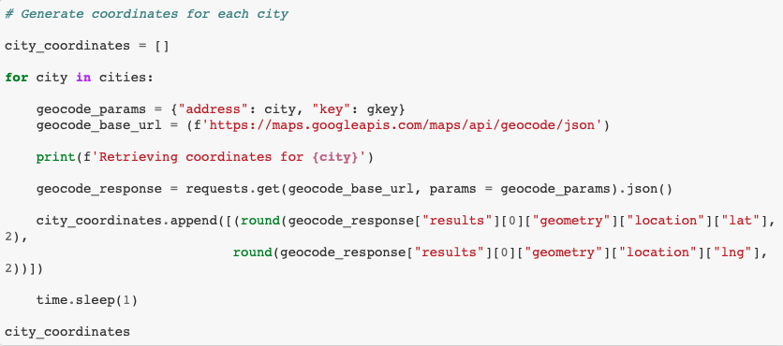

Slide 28
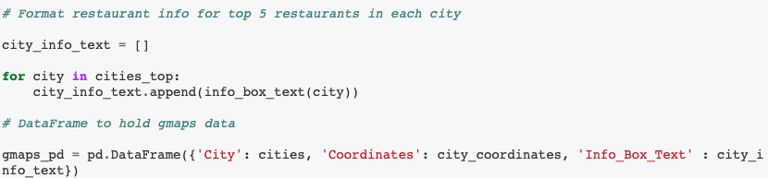

Slide 29
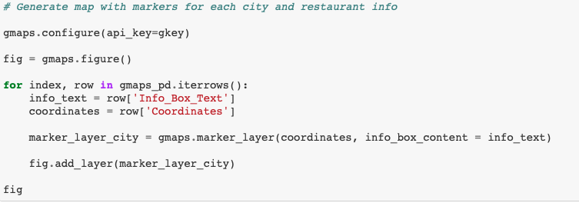

Slide 30
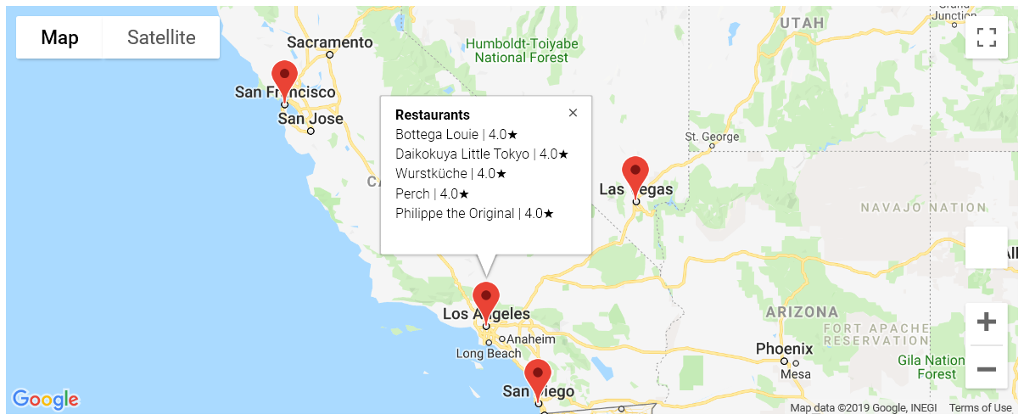

Slide 31
Results
Breakfast & Brunch and American are the most popular cuisine choices overall.
Portland may be the most popular due to the initial research, but it’s not the most diverse.
San Francisco is the priciest place to eat out, on average, of all the cities rated
Los Angeles has the most variety in cuisine choices
If you’re hungry, the West Coast has the most variety of options for you to explore!

